Slide 1
Prefetch Procrastinator for Android
Akshay Kamath
Amish Shah

Slide 2
Project Description
Prefetched contents at the time of launch gets rendered quickly and improves user experience
Unavoidable data usage

Slide 3
Design
Android
App Source Code
Procrastinated Version of App (Source Code)
Procrastination Library

Slide 4
Design
Android Common Pattern
Activity 1{
var1 <= networkFetch(url1)
textView.setText(var1)
var2 <= networkFetch(url2)
startActivity2(var2)
}
Activity 2{
textView.setText(var2)
}

Slide 5
Design
Detect n/w prefetch variables
n/w call for prefetch variable
Connected to Wi-fi
Store the URL (url2) and corresponding variable (var2)
Use of prefetch variable (var2) detected
No
Yes
Execute network call for prefetch

Slide 6
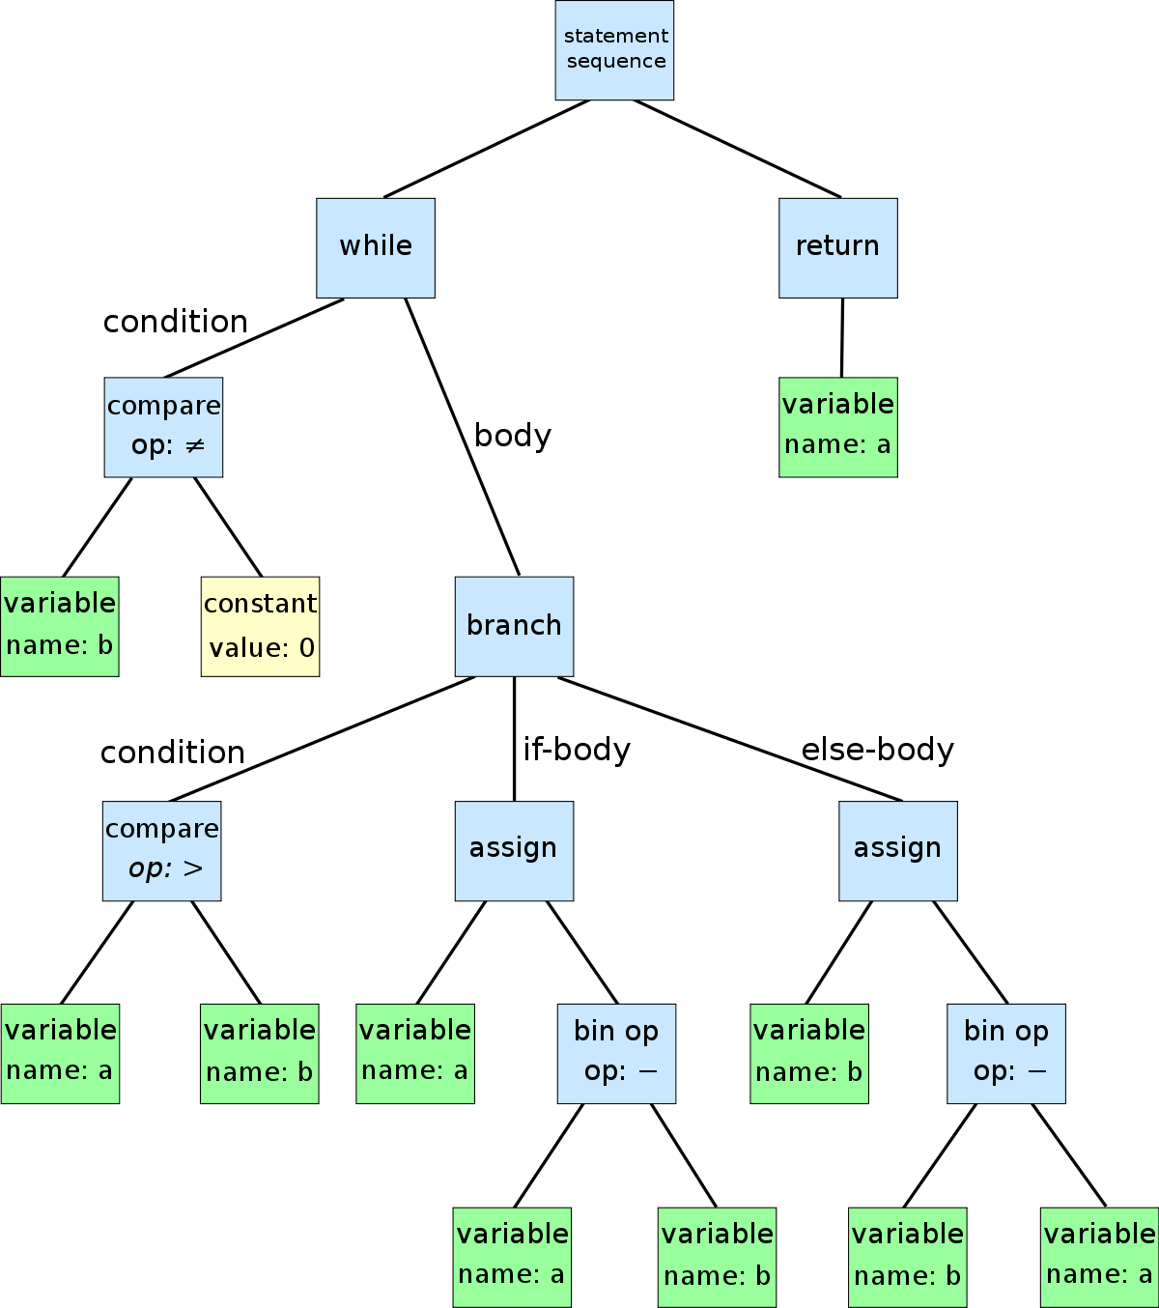
Method – Static Analysis: ASTs
while(b ≠ 0){
if (..)
..
}
return a;

Slide 7
Method – Static Analysis: General
Track Intent Calls
No, check for
next variable
Prepare a list of all the variables passed in intent
Is variable a network call?
Procrastinate prefetch call for this variable
Yes

Slide 8

Method – Track User Movements
Detect n/w prefetch variables
n/w call for prefetch variable
Connected to Wi-fi
Store the URL (url2) and corresponding variable (var2)
Use of prefetch variable (var2) detected
No
ViewPrefetch
Correlation Score
Yes
Execute network call for prefetch

Slide 9
View Prefetch Correlation (VPC)
Key Limitation: General User Adaptability
Proposed Solution: Perform Study of Prefetch Necessity using VPC
For each time a prefetch is performed, evaluate how many times a view is invoked
Implemented as a part of the package.

Slide 10
Approach & Implementation
Implement a Simple POC Weather App, with the prefetch pattern and 2 screens
First Screen – Prefetch
Second Screen – Use the prefetch data
Implement Instrumentation and Procrastination tool for desktop
Implement Measurements Library for data usage and VPC measurement
Implement Android Procrastination Library

Slide 11
Evaluation Methodology
Provide it to 4 users
User study for 5 days
2 Users – Prefetch App , 2 Users – Prefetch Procrastinated App
Track view prefetch correlation
Track network data usage of app for each day per user

Slide 12
Results

Slide 13
Results – Procrastinated vs Non Procrastinated

Slide 14
Results Summary
Comparing User 4 to User 1 yields 27% savings in data
Comparing User 3 to User 1 yields 41% savings in data
User 4 VPC > User 3 VPC. Hence User 4 consumes more data.
Mean Saving of 34%

Slide 15
Limitations
Limited to one pattern only
Limited to Java source code
Requires developer involvement

Slide 16
Potential Future Work
Implement for POST based prefetch
Analyze at Byte Code level
Identify more patterns

